Slide 1

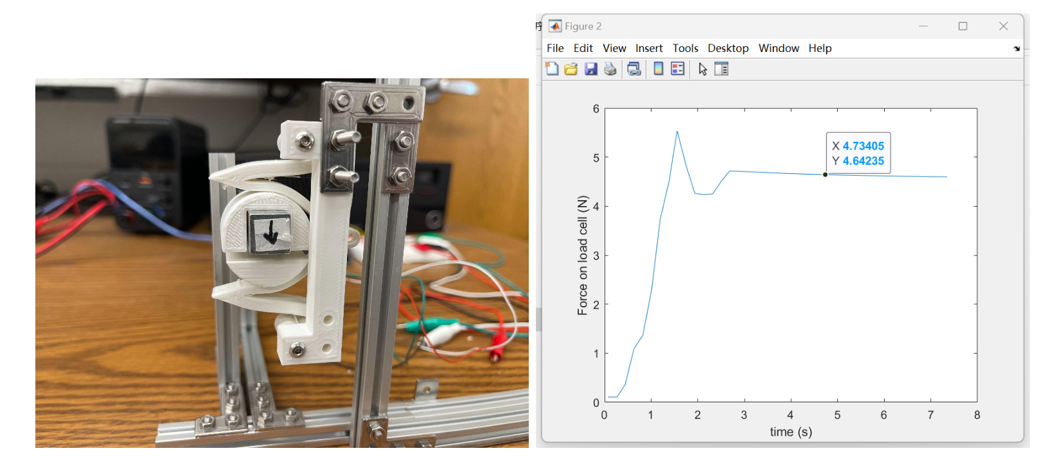
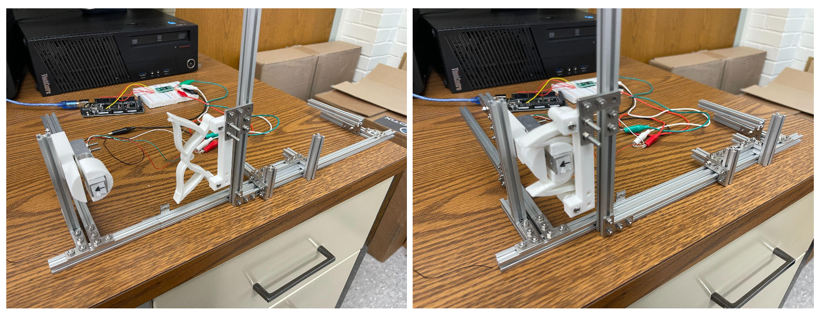
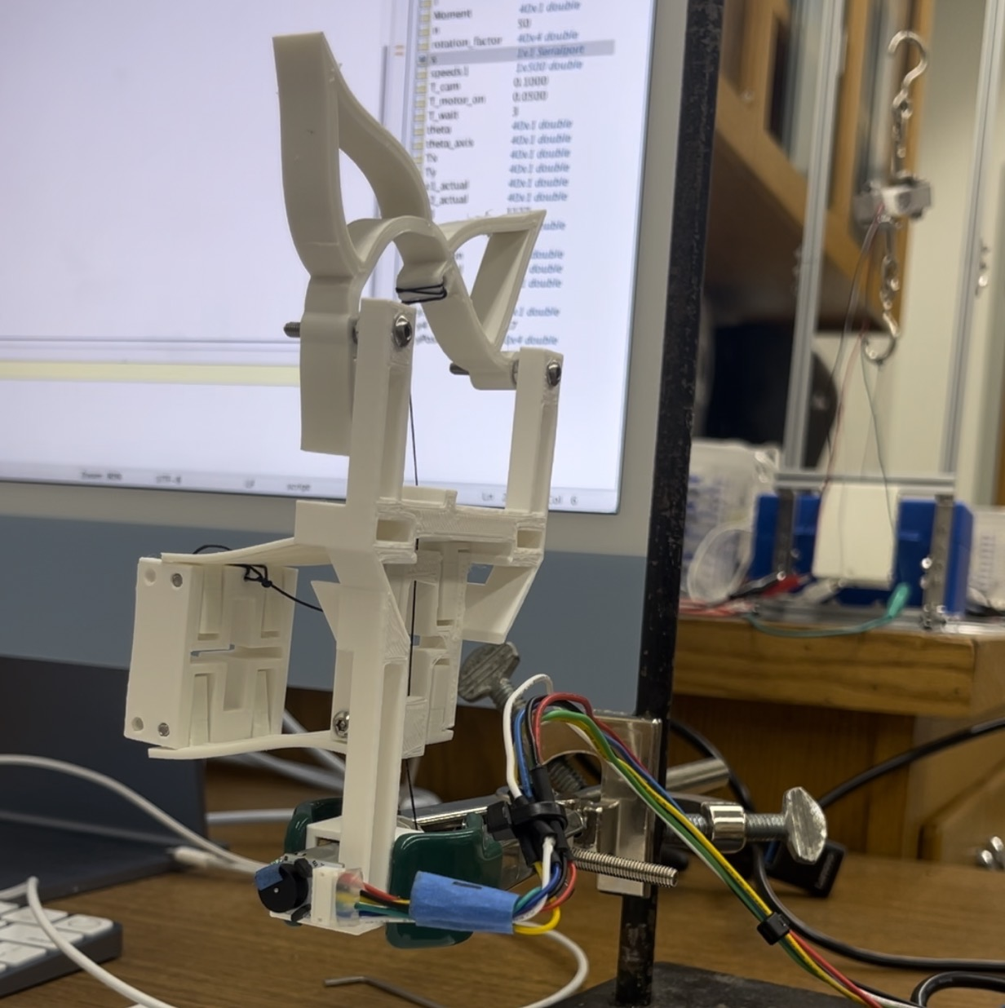
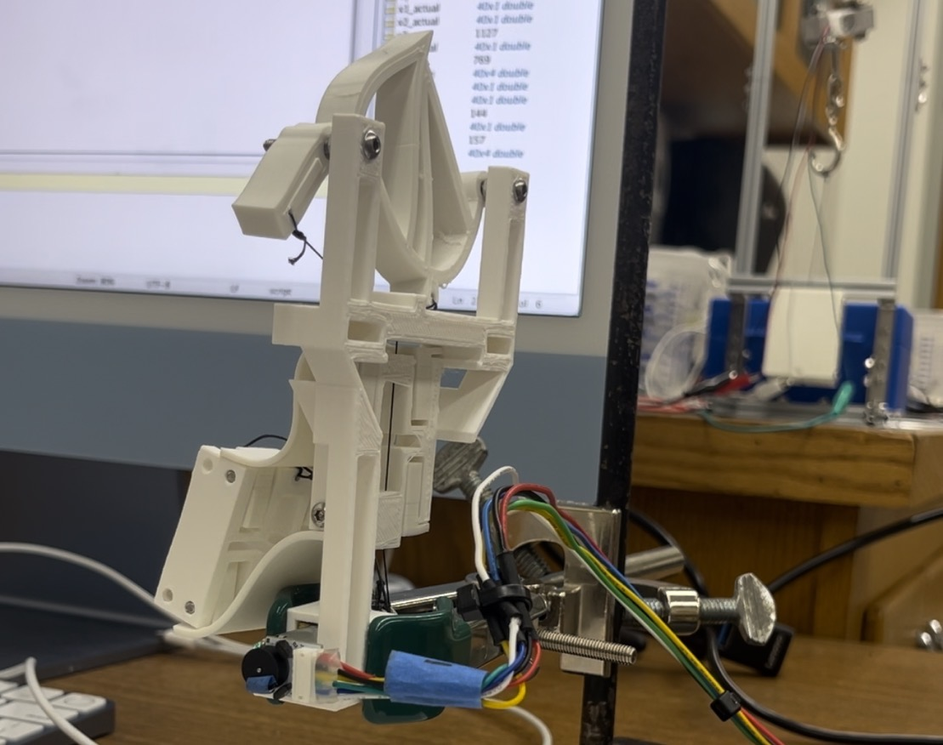
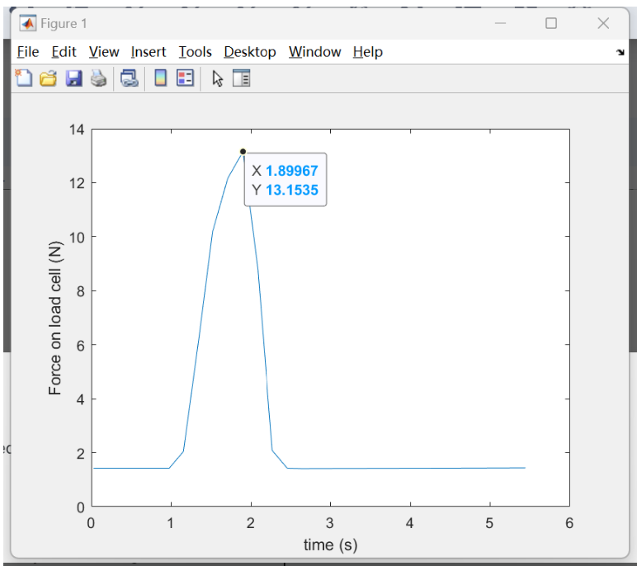
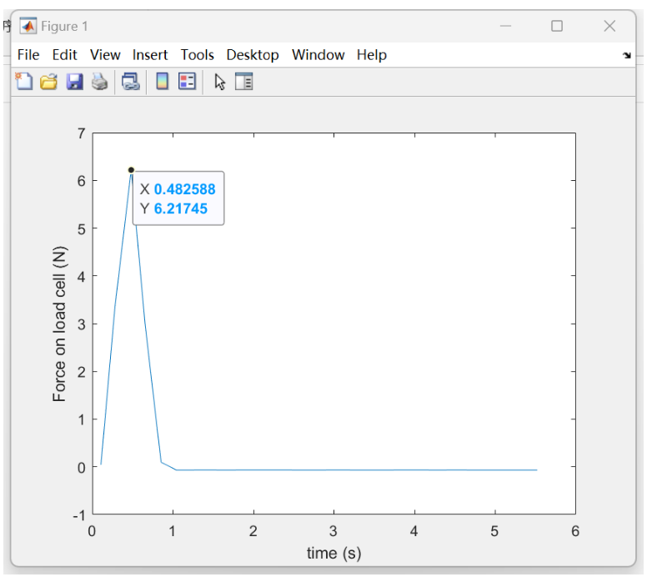
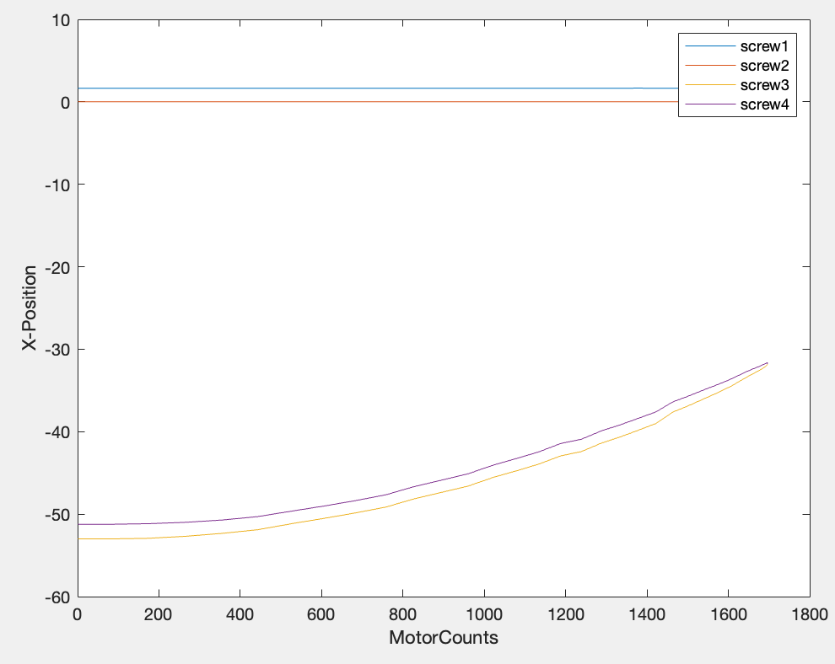
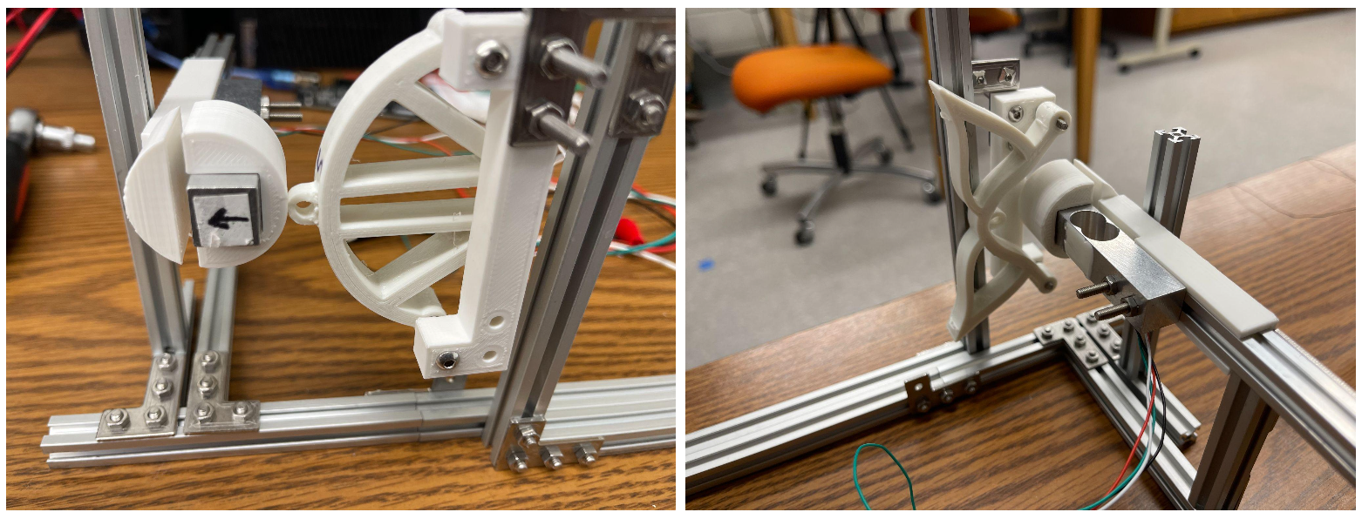
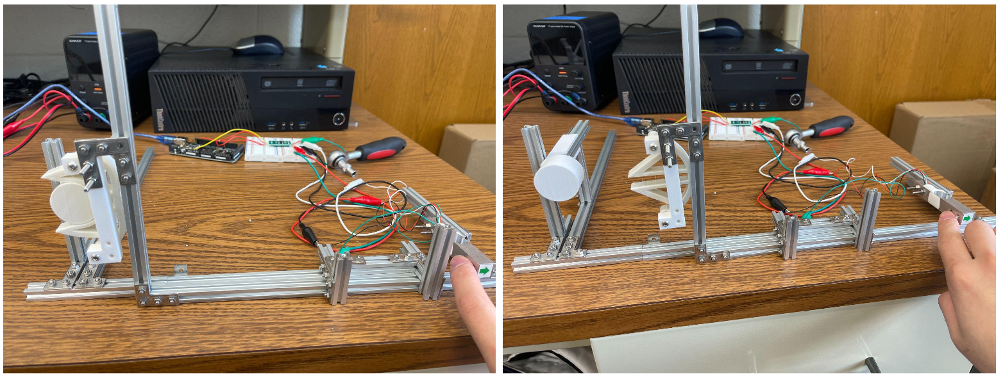
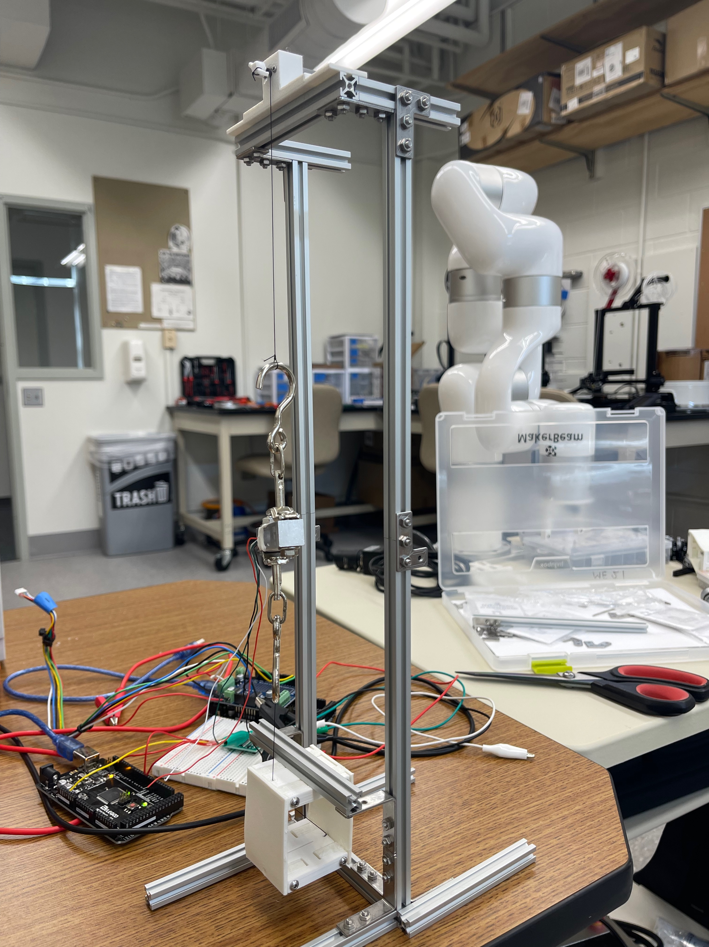
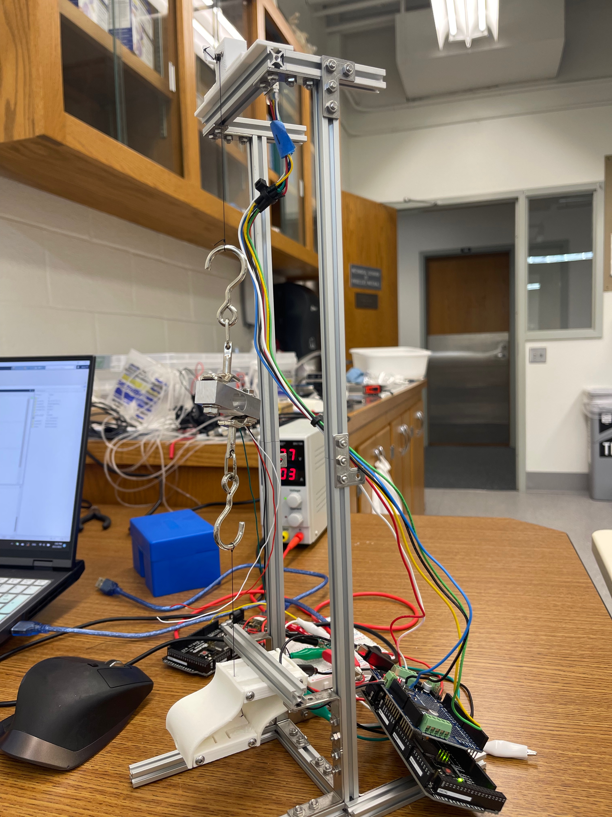
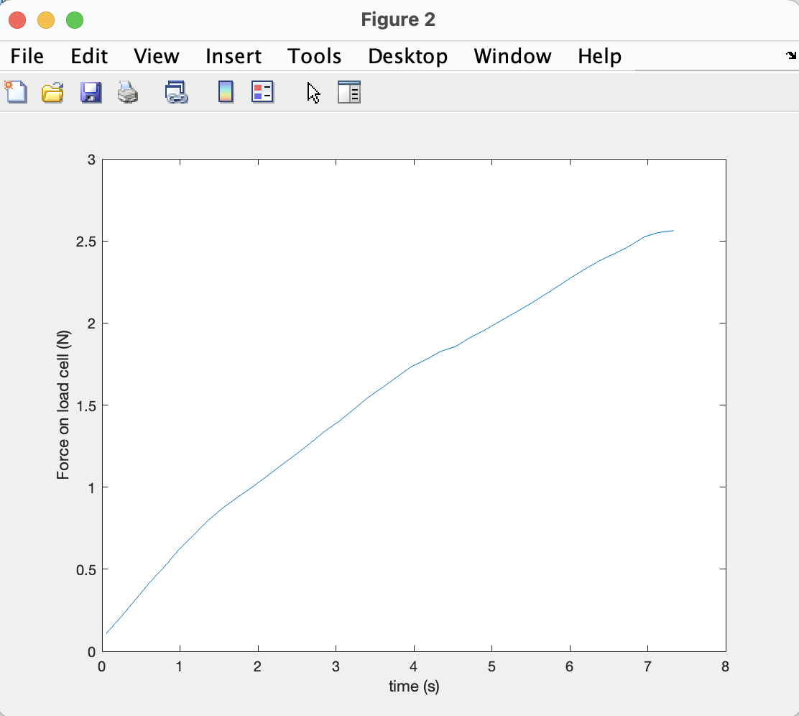
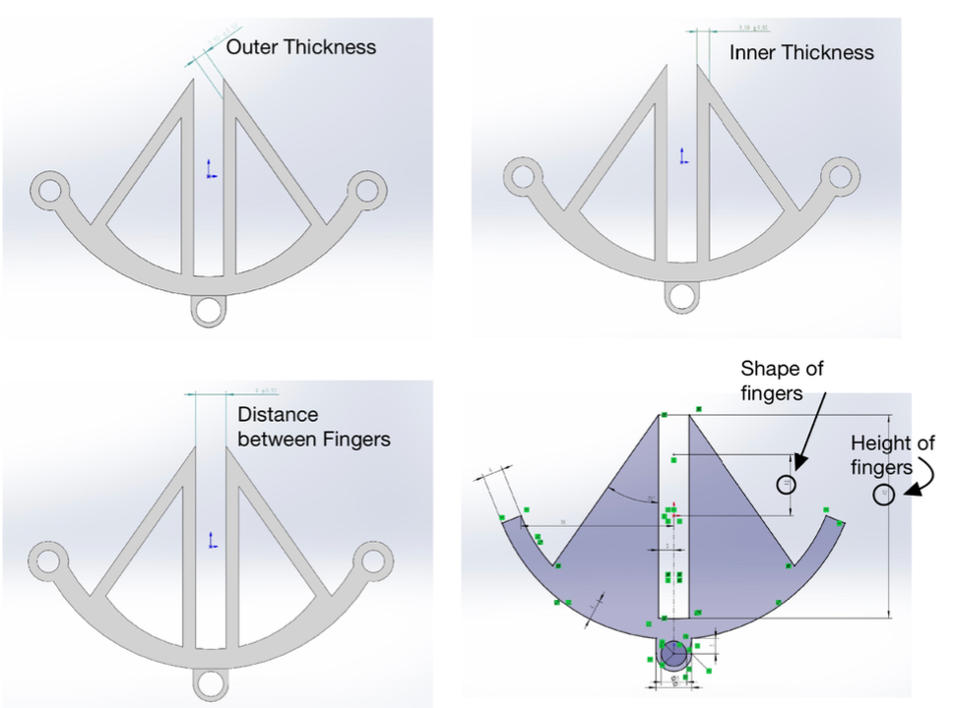
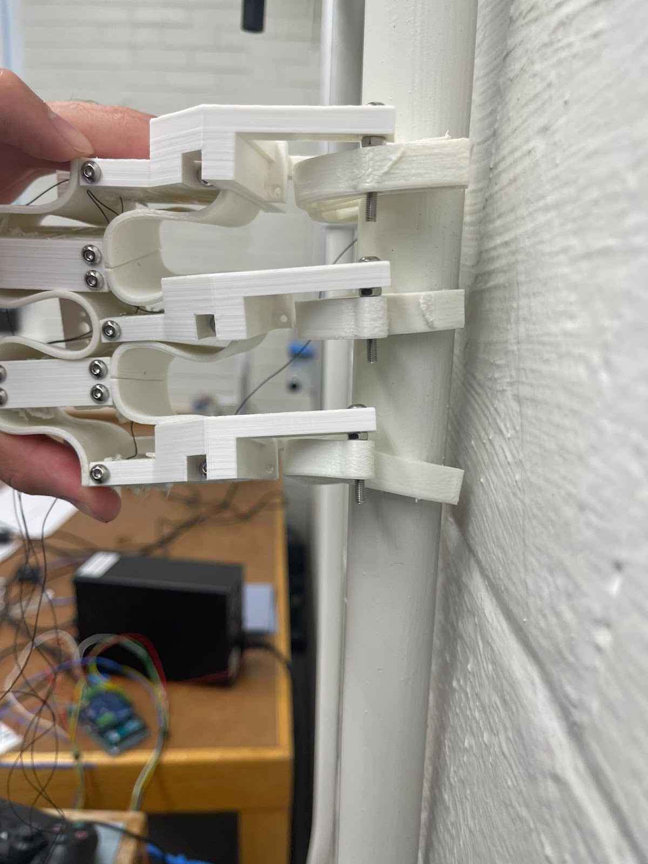
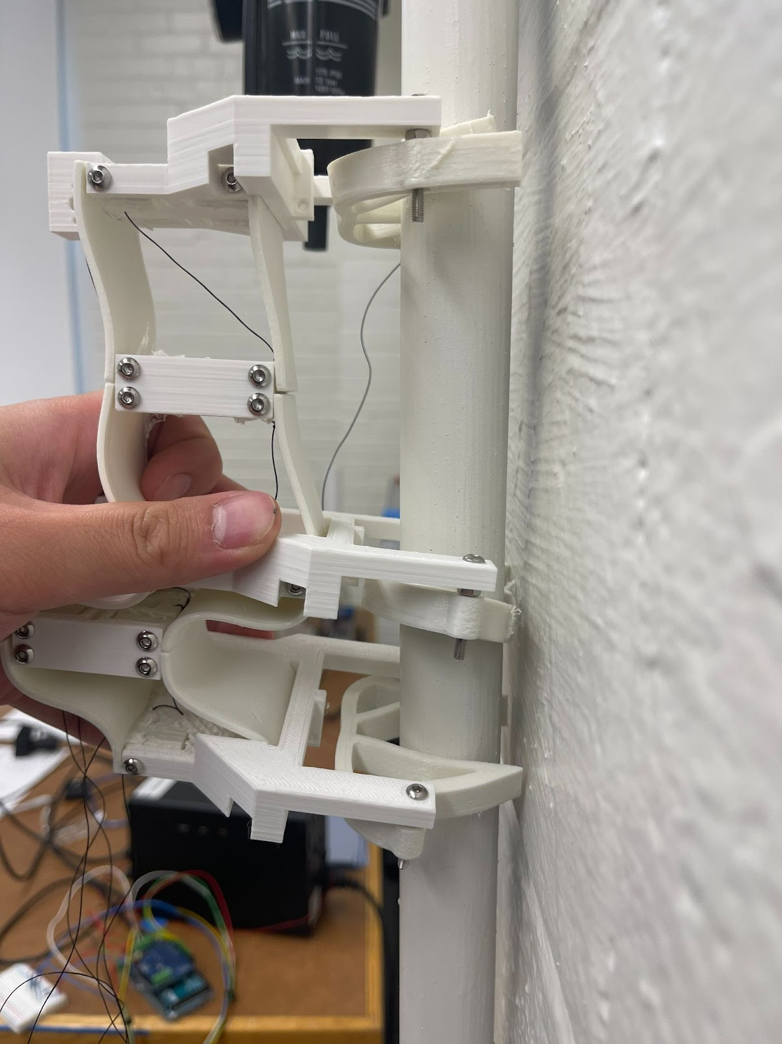
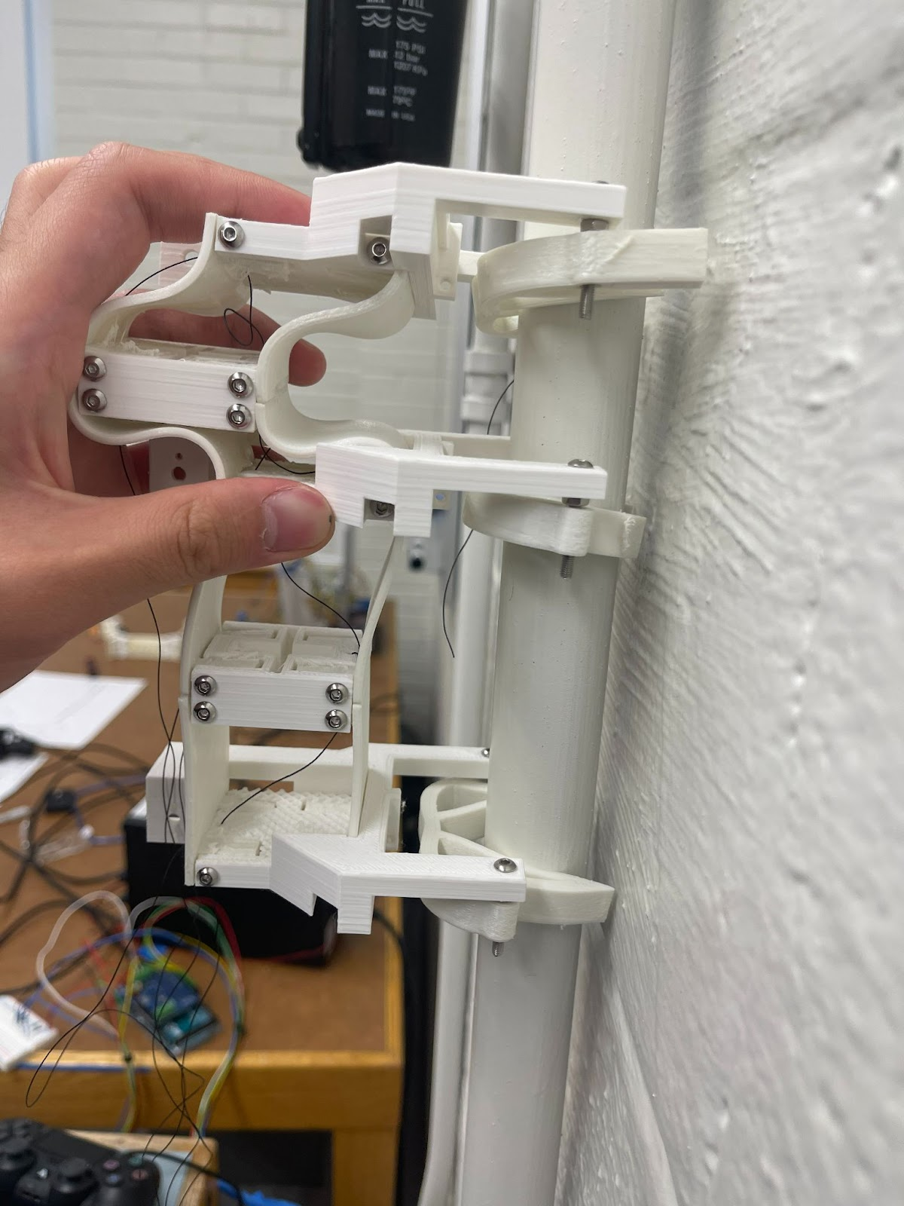
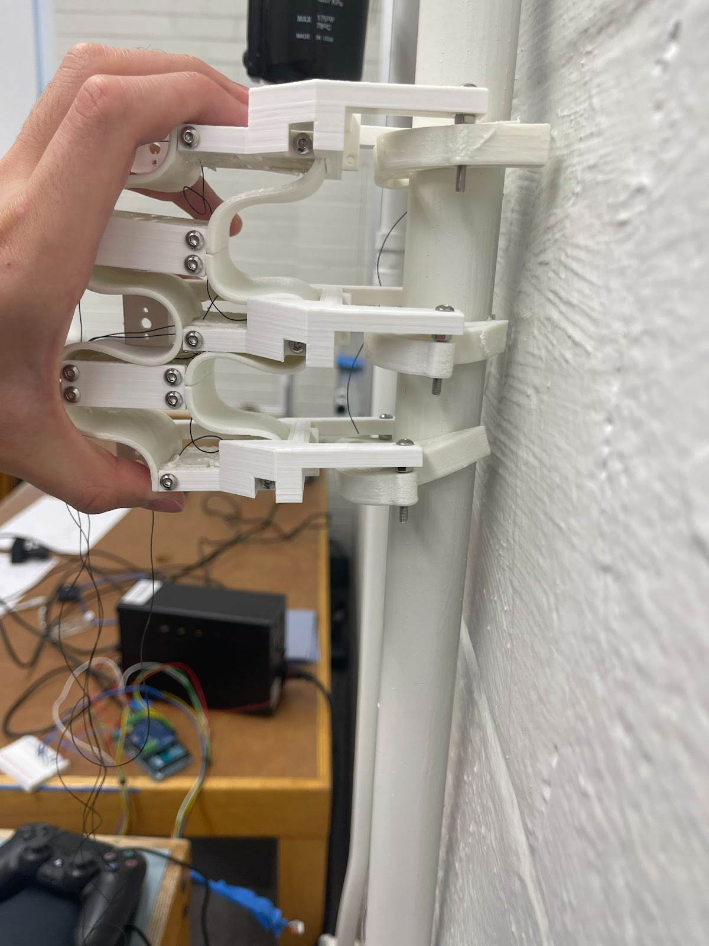
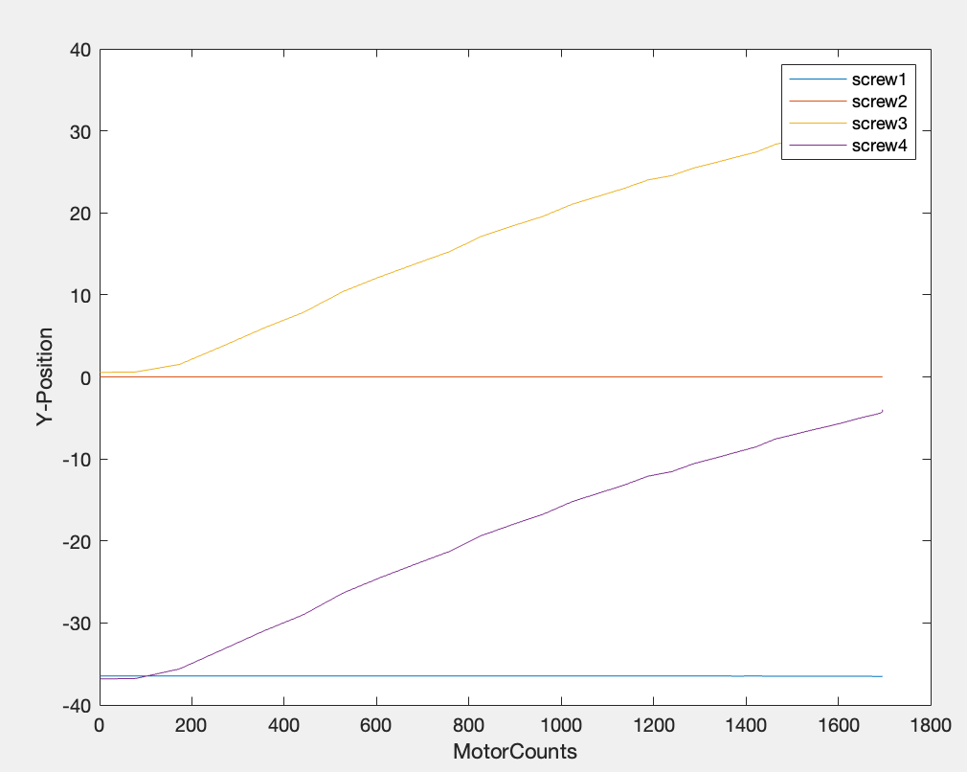
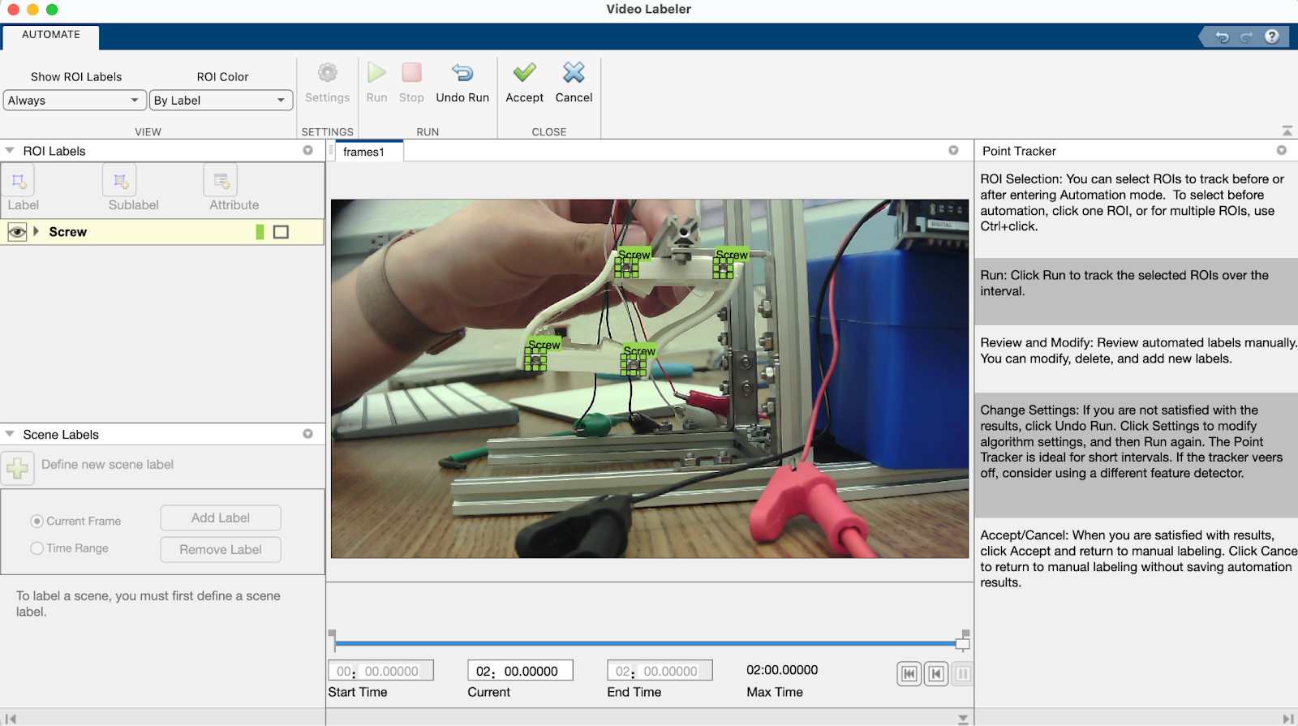
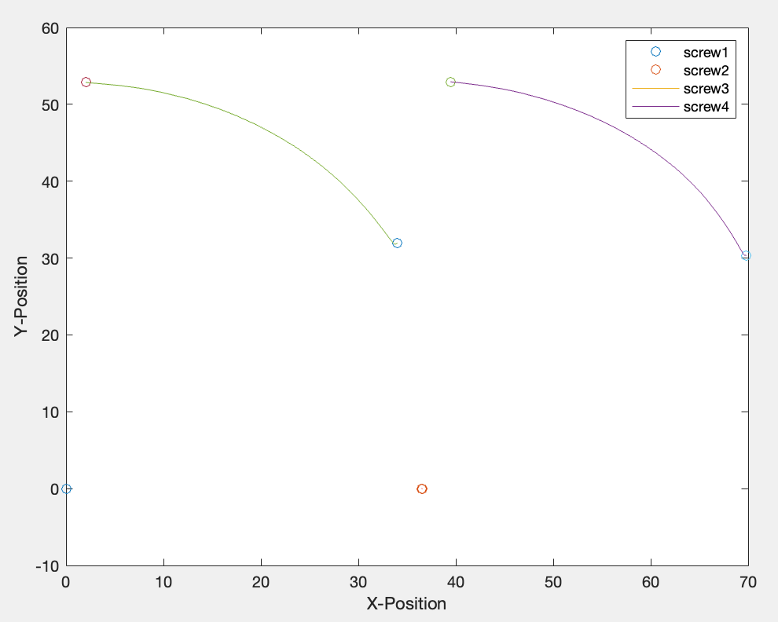
Development of Soft Gripper and Body for Caterpillar-inspired Robot
Kevin Wu
Advised by Prof. William Scott
Department of Mechanical Engineering, Bucknell University, Lewisburg, PA.
Abstract
This project is designing a caterpillar-inspired robot that can climb on pipes or branches. The project involved creating 3D models of clamps and brackets using Solidworks and Ultimaker Cura and printing hard and soft parts using PLA and Filaflex respectively. The force sensors are connected to the Arduino board to collect force data, which is analyzed using MATLAB. The N20 motor is used to activate and reset the grippers and pull up rigid parts of the body to deform. The design process involved exploring different gripper and body designs, including those with flat and curved stems as well as fin ray designs. Finally, data were collected to evaluate the force ratio metrics and predict the movement of the body. We aim to create a gripper with the highest force ratio and coordinate the body with the gripper to help to robot climb on the pipes. In the experiment, we measured the four forces of each gripper and find the parameters that have the most positive effect on gripping and extracting force and the most negative effect on less closing and opening force which helps the grippers work much better helping caterpillar robots to move, climb and hang. The force required to pull up the body was also measured and analyzed with position.
Introduction
Data Collections
Results
Using Arduino and MATLAB coding, single segment with both gripper and both can be operated in the desired way shown in Figure 10.
Every species on the earth has its own advantages and disadvantages, and engineers have been learning from other species for decades and have developed fantastic ideas and concepts through studying them. Caterpillars are remarkable organisms, which are able to grip and climb on various terrains such as tree branches, or pipes. The special gripping and climbing abilities of the caterpillars have inspired researchers to create plenty of bionic designs which make human lives much easier.
"In recent years the innovative research field of soft robotics has enable engineers to complete all kinds of tasks more adaptively and naturally. Also, they can adapt to various kinds of circumstances and interact with different shapes of objects due to the variability of the material and design. Overall, research in soft robotic aims to create designs that can improve our daily lives and get to know more about various creatures in nature and utilize their characteristics which can benefit us.
The forces data for the grippers with different parameters are collected to evaluate their efficiency as shown below
Among those grippers, gripper 6 has the largest extracting versus opening ratio. Gripper 9 has the largest gripping versus opening ratio. Gripper 14 has the greatest closing versus opening ratio.
To predict the position data of the each screws on the segment at certain motor count, plots of position versus count was obataine.
Figure 1:Device used to measure the gripping force and an example graph
Figure 2:Device used to measure the closing force
Figure 10: Single segment was successfully controlled and functionable
Figure 3: Device used to measure the opening force
Discussion
Figure 4: Example graphs of closing/gripping force
The gripper part of this project is quite successful. Currently the body segments is in progress and the gripper is working on the body. The robot can climb up the pipe as pattern shown in Figure 11. The motor count is defined in Table 12. The cooperation between the body and gripper will be done in the future work.
Figure 5: Device used to measure the extracting force
Figure 6:Device used to measure the pulling force and an example graph
Methods
In this project, we use Solidworks to create a 3D model of both the grippers, bodies and holders. The sldprt files were converted to gcode files by Ultimaker Cura. There are two types of 3D printers, PLA is used in Artillery Sidewinder XI to print hard parts. Filaflex is applied in the CREALITY ENDER3 S1 printer to print soft parts, which are the grippers with customized settings. Computer vision toolbox in Matlab is used for analyzing the motion.
N20 motors are attached to the 40lb fish wire to open the gripper and actuate the body. To operate the motor, Mega2350, and Arduino motor shield are required. Matlab and Arduino IDE are used as well. NANKADF power supply provides the 6V required for the motor.
To track the movement of the robot, the Video Labeler Apps was used in MATLAB.
Figure 11: Demonstration of how the body of robot working with grippers
Start | Motor 1 Count | Motor 2 Count | Motor 3 Count
Motino 1 | 0 | 0 | 0
Motion 2 | -1500 | 0 | 0
Motion 3 | +1500 | -1500 | 0
Motion 4 | 0 | +1500 | -1500
Motion 5 | 0 | 0 | +1500
Figure 7: Demonstration of the parameters
Table 12: Designed Motor Count for the robot
Conclusion
This project successfully designs a bistable and soft gripper for a caterpillar-inspired robot and the body with fin-ray design. Future work need to be done of collaborating these parts to make the robot move.
Figure 8: Demonstration of how we track each screw on one segment of the body and the corresponding plots
Figure 9: Plots of motor count versus X/Y position of each screws and wire length

